Slide 1
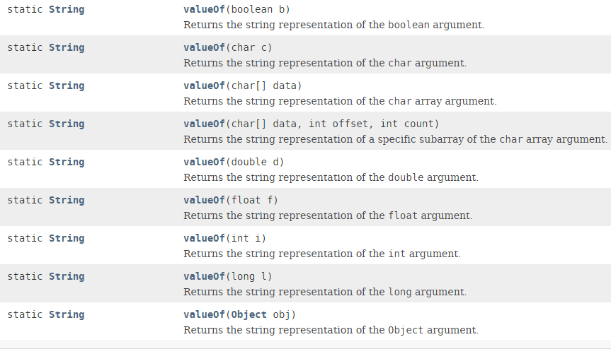
String – valueOf Method
The java string valueOf() method converts different types of values into string. By the help of string valueOf() method, we can convert int to string, long to string, boolean to string, character to string, float to string, double to string, object to string and
char array to string.

